Slide 1

Chaichology shop SQL Analysis

Slide 2




Challenge
Challenge is to craft SQL queries to extract insights from the Chaichology Shop database.

Slide 3



Tables
01
02
03
04
Ratings
Sales
Contain rating and review details of item.
Contain sales detail of each shop.
Tea shops
Menu items
Contain details of shop branch with location.
Contain the details like Item, price, category Chaichology serves.

Slide 4

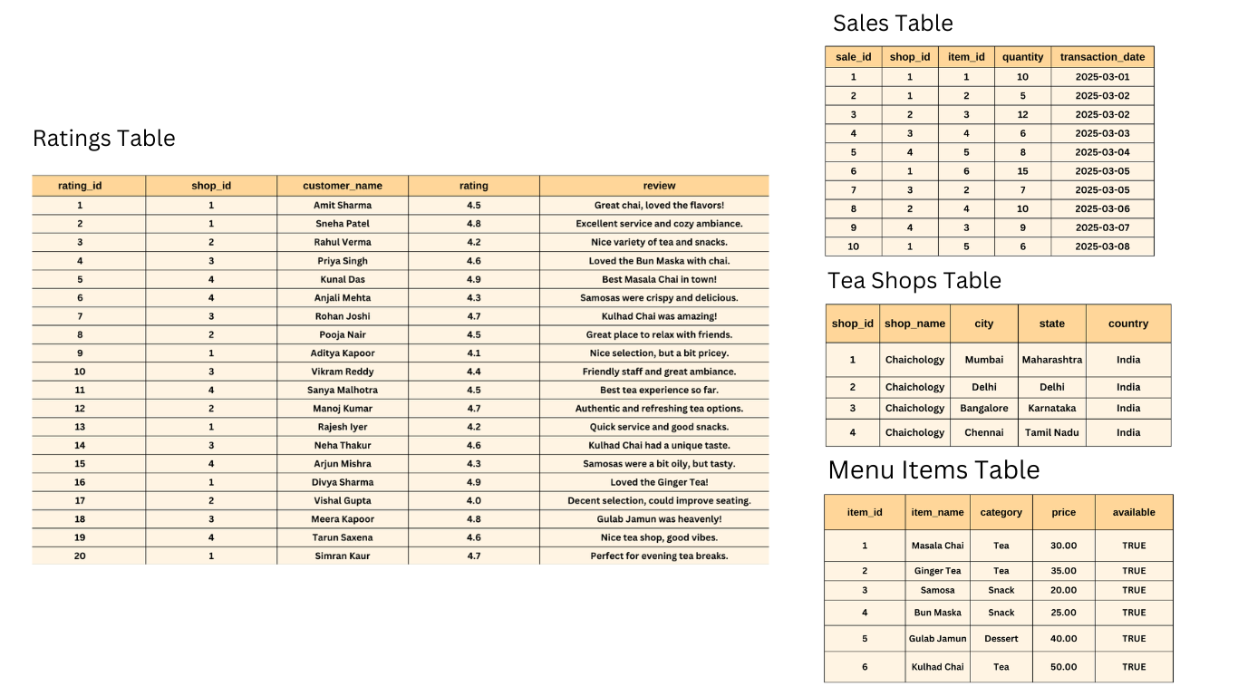
Table Details

Slide 5
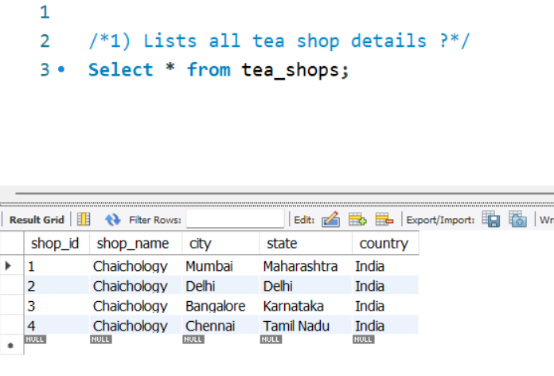



Question 1
1) Lists all tea shop details ?

Slide 6
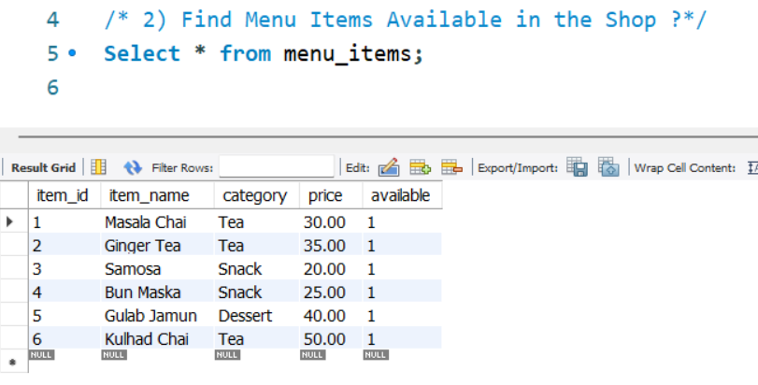

Question 2
2) Find Menu Items available in the Shop ?

Slide 7


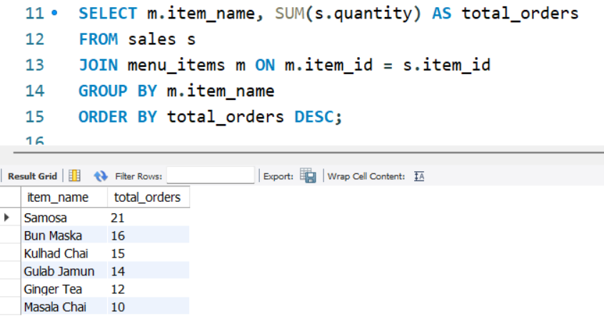

Question 3
3) Find the total number of Orders for each Menu Item ?

Slide 8
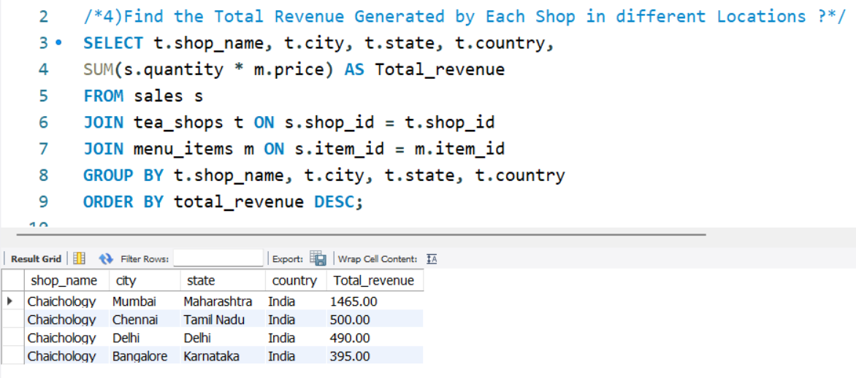

Question 4
4) Find the Total Revenue Generated by Each Shop in different Locations ?

Slide 9

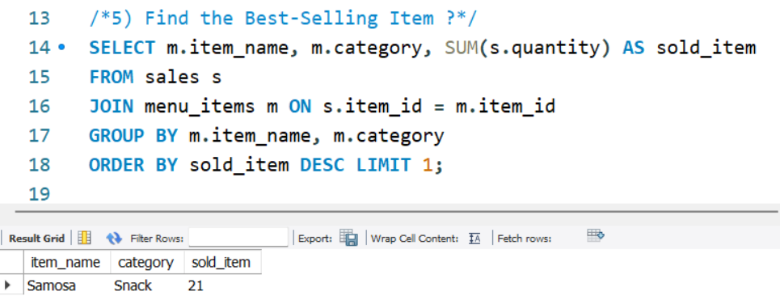

Question 5
5) Find the Best-Selling Item ?

Slide 10
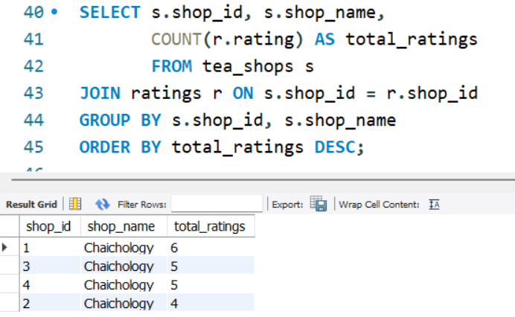


Question 6
6) Count the Total Number of Ratings for Each Shop ?

Slide 11

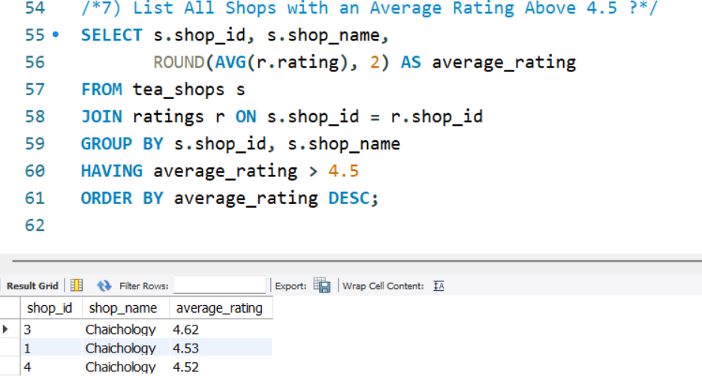

Question 7
7) List All Shops with an Average Rating Above 4.5 ?

Slide 12

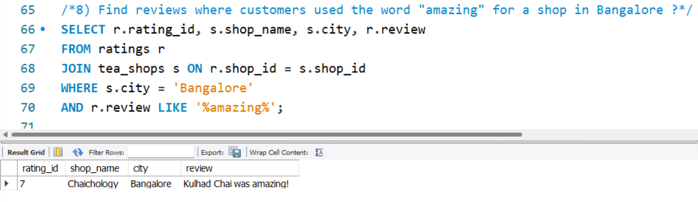

Question 8
8) Find reviews where customers used the word "amazing" for a shop in Bangalore ?

Slide 13
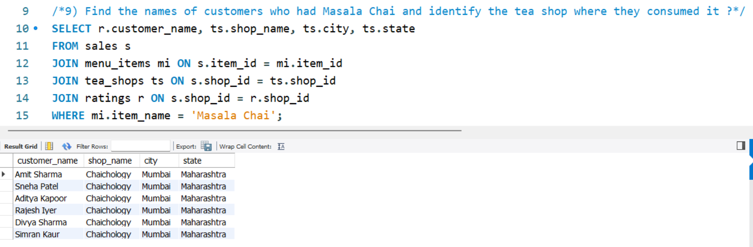

Question 9
9) Find the names of customers who had Masala Chai and identify the tea shop where they consumed it ?

Slide 14
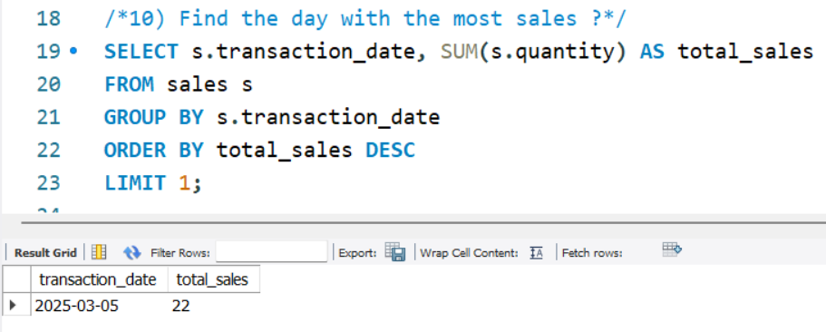

Question 10
10) Find the day with the most sales ?

Slide 15


Thank You

